Slide 1



Business Insight 360
Data Analytics Project For Atliq Hardware
Atliq Hardware

Slide 2

Introduction About Company
AtliQ Hardware is a global electronics company offering products like laptops, desktops, accessories, and networking devices. It operates across APAC, Europe, North America, and Latin America. This project focuses on improving business insights using Power BI to support smarter, data-driven decisions.
Atliq Hardware

Slide 3

Data Dependency on Excel
Business Problem
AtliQ relied heavily on Excel files for analytics, making it difficult to manage and analyze large volumes of data across multiple regions.
Lack of Actionable Insights
Excel reports were time-consuming and ineffective in generating real-time insights for decision-making
Financial Loss in LATAM Region
Due to poor data visibility and delayed analysis, the company faced major losses in the Latin American market
Atliq Hardware

Slide 4
Project Objective
Data-Driven Decision Making
Revenue Growth & Efficiency
Regional Performance Visibility
Unified Business View
Developed an interactive Power BI dashboard to help AtliQ Hardware make faster and smarter
business decisions
The dashboard enabled analysis of department-wise sales trends, driving a projected 10% revenue increase and 20% reduction in data-related expenses.
Enabled managers and executives to easily track performance across regions and sub-regions, improving understanding of customer trends.
Provided a single source of truth for all departments to monitor performance and align strategic goals globally.

Slide 5
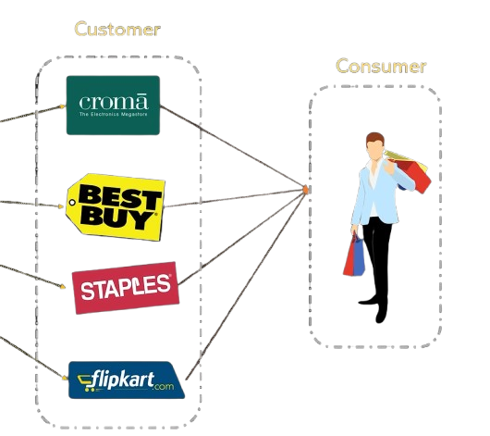
Business Model Overview
Customer
Consumer
Atliq Hardware

Slide 6






Platforms
Customer Type
AtliQ Hardware serves customers through offline retail stores and online e-commerce platforms
Brick & Mortar
E-Commerce

Slide 7











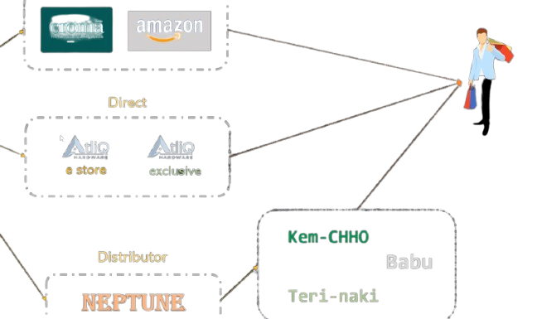















Retailer
Distribution Channels
AtliQ’s overall product distribution flow — from manufacturing to retailers, direct stores, and customers.
Direct
Distributer
Teri Naki
Atliq Hardware

Slide 8







Data & Tools Overview
Data Sources
🛠 Tools Used
📅 Fiscal Year Information
SQL Database
Excel Files
Power BI
Power Query
DAX Studio
MySQL
    Fiscal year runs from September to August
    Data covers 2019, 2020, 2021, and 2022 (estimated)

